Slide 1
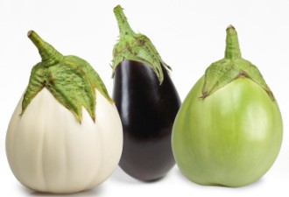
Who stole our Brinjal varieties for Genetic modification?
Malpur Local Manjari Gota Kudachi Local Udupi Local
112 GO
Pabkavi Local
Local Brinjal varieties accessed in Blatant violation of the Biological Diversity Act, 2002, Biological Diversity Rules, 2004 and Karnataka Biodiversity Rules, 2006.

Slide 2
STOP Large scale violation of Rule 14 of the Biological Diversity Rules, relating to “Procedure for access to biological resources and associated traditional knowledge”.
Our Traditional Knowledge on sale from Multi National Seed and Pharmaceutical companies

Slide 3
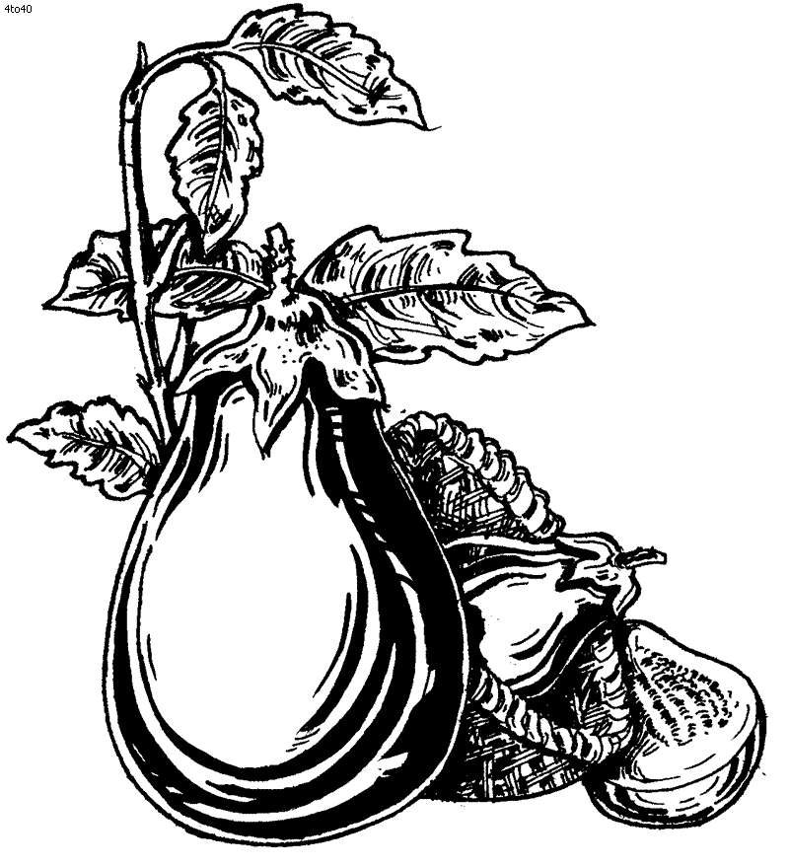
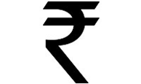
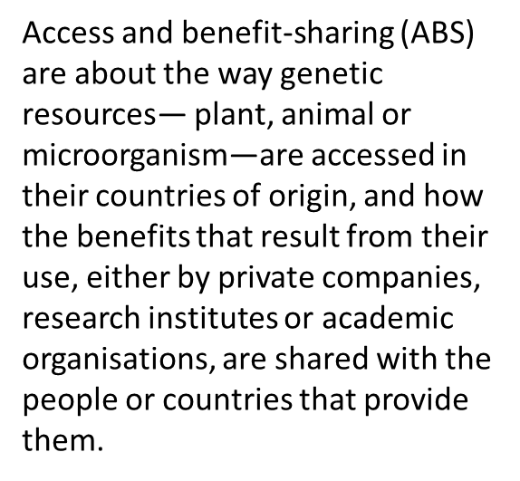
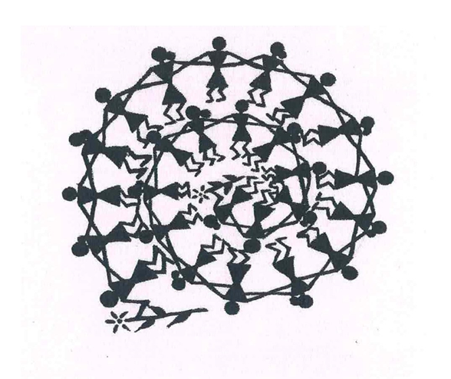
Who is making money genetically modifying our Brinjal?
Sec. 21 of the Biological Diversity Act, guarantees due rights to Local Communities under the Access and Equitable Benefit Sharing

Slide 4
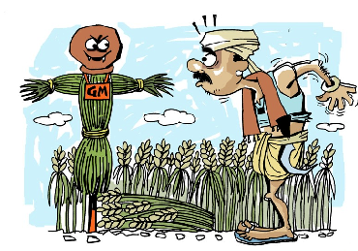
WATCH OUT
We own your land, your seeds and soon your DNA!

