Slide 1
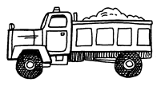
Progressive, Sustainable and Immediately Feasible ways to manage Municipal Solid Waste Submitted to Hon’ble High Court of Karnataka by Environment Support Group and anr., Petitioners in WP No. 46523/2012 www.esgindia.org esg@esgindia.org
WASTE SEGREGATION
AT SOURCE
Pourakarmikas
Pourakarmikas and waste pickers
Pourakarmikas
Biodegradable
Recyclables
Waste pickers
should be formalised.
This creates livelihoods
Hazardous,
Electronic and
Bio-medical waste
Incentivize composting at source
Composting /
Vermi-composting/
Community Biogas units at
Local levels in every ward
Sorting,
and
Recycling in
every ward
Treatment
Manure for
Urban home gardens
and parks
Recovery in
respective industries/
processing centres
Treatment of toxic waste and disposal of inerts in
regulated landfills

Slide 2
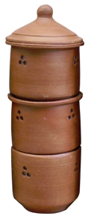
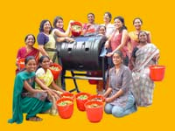
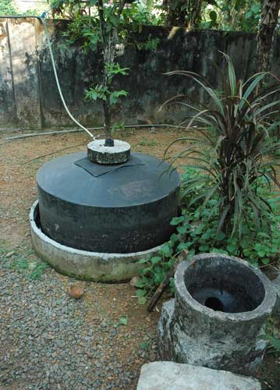
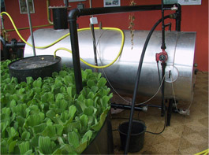
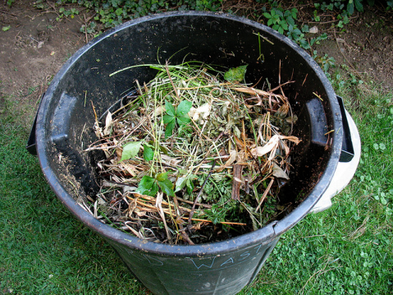
Making Bangalore a Waste less city
WET WASTE/BIODEGRADABLE WASTE
Households bigger than 40 x 60 feet square
Bulk Generators (Apartments, Schools, Hotels, Markets )
Small Households and Low income neighbourhoods
Compost wet waste (Kitchen and garden )at source mandatory using Daily dump Kumbha/Bucket /Compost pit
Compost wet waste at source using Daily Dump processor/ Compost pit /Biogas plant
BBMP provides Daily dump Manthans/Space in civic amenity site for composting through compost pits or builds biogas plants for the community

Slide 3
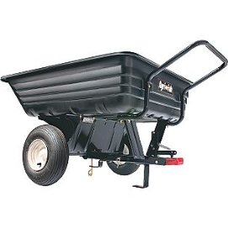
Making Bangalore a Waste less city
DRY WASTE-RECYCLABLES, REUSABLES
Households bigger than 40 x 60 feet square
Bulk Generators (Apartments, Schools, Hotels,Markets )
Small Households and Low income neighbourhoods
Pks, Rag pickers
Dry Waste collection centres- BBMP Identified local ward level raddiwalas, Dry Waste collection centres
Paper, Cardboard
Glass, tin, plastic recycled

